Slide 1
Databricks_Activity

Slide 2
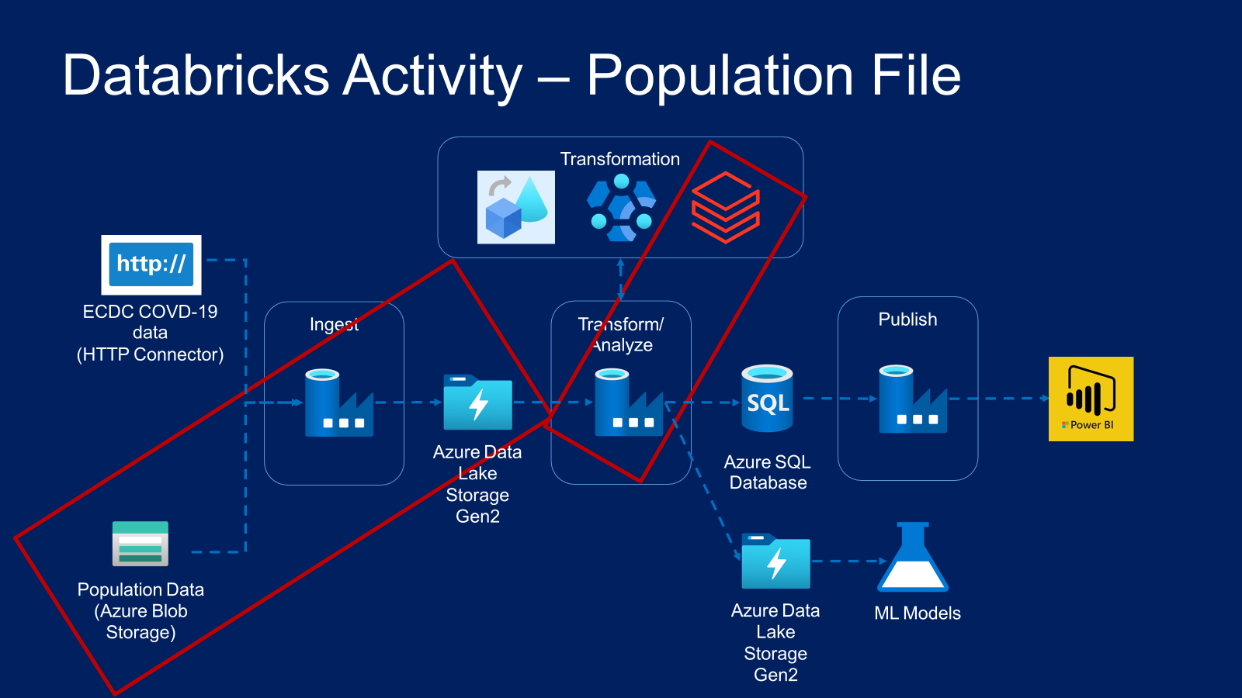

Slide 3
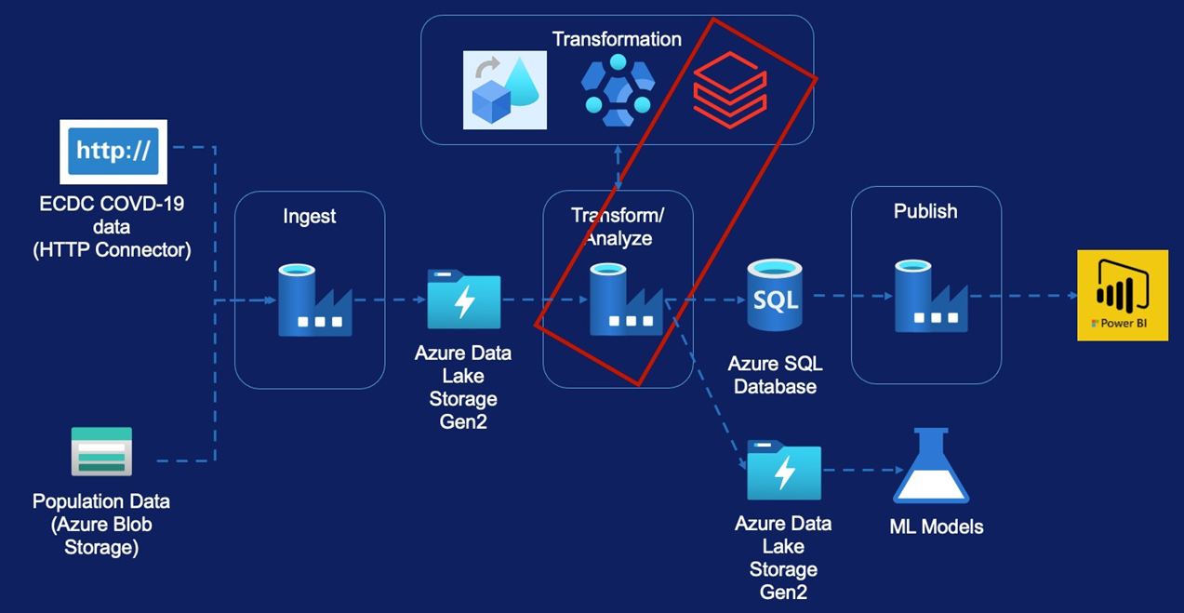
Databricks Activity – Population File
Create Databricks Service
Create Databricks Cluster
Mount Storage Accounts
Transformation Requirements
Creating Pipeline

Slide 4
Databricks Environment Set-up
Creating Databricks Service
Creating Databricks Cluster

Slide 5
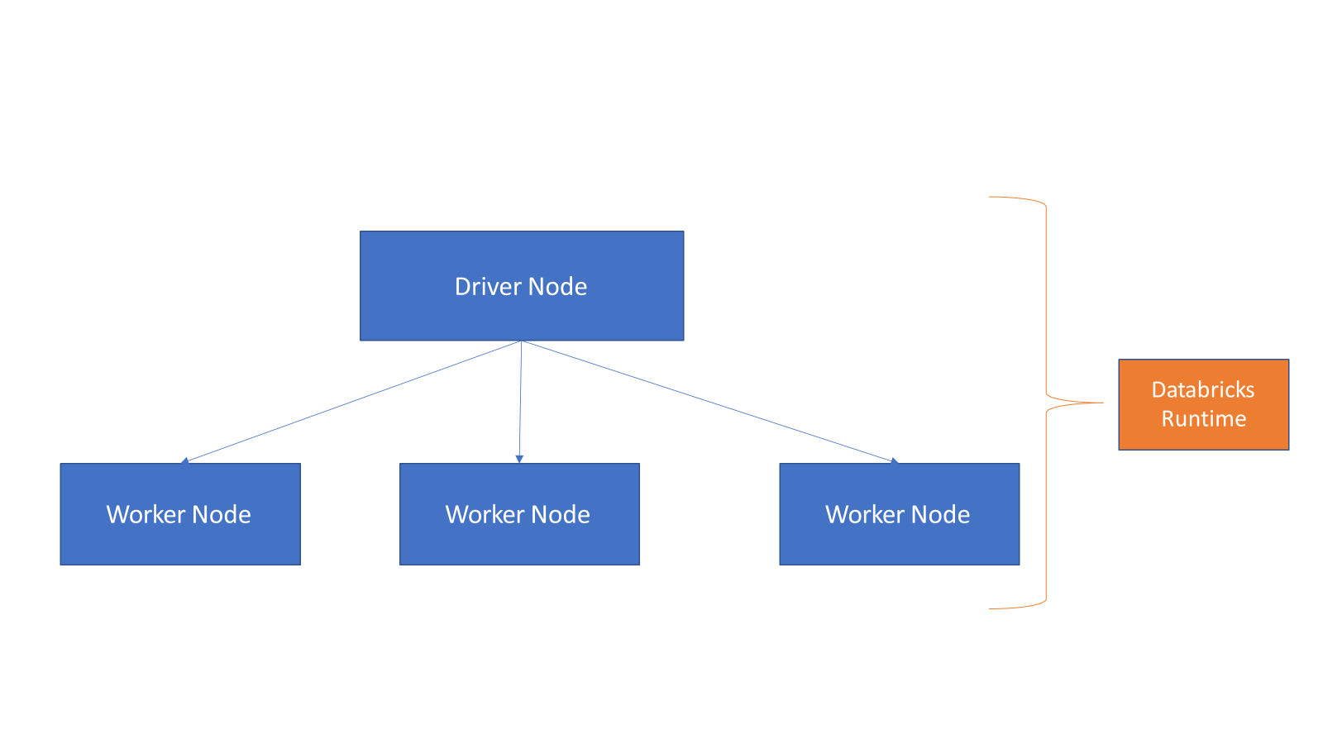
What is a Cluster?

Slide 6


Cluster Types

Slide 7
Mounting Data Lake Storage

Slide 8
Mounting Data Lake Storage
Create Azure Service Principal
Grant access for data lake to Azure Service Principal
Create the mount in databricks using Service Principal

Slide 9
Transform Population by Age Data

Slide 10
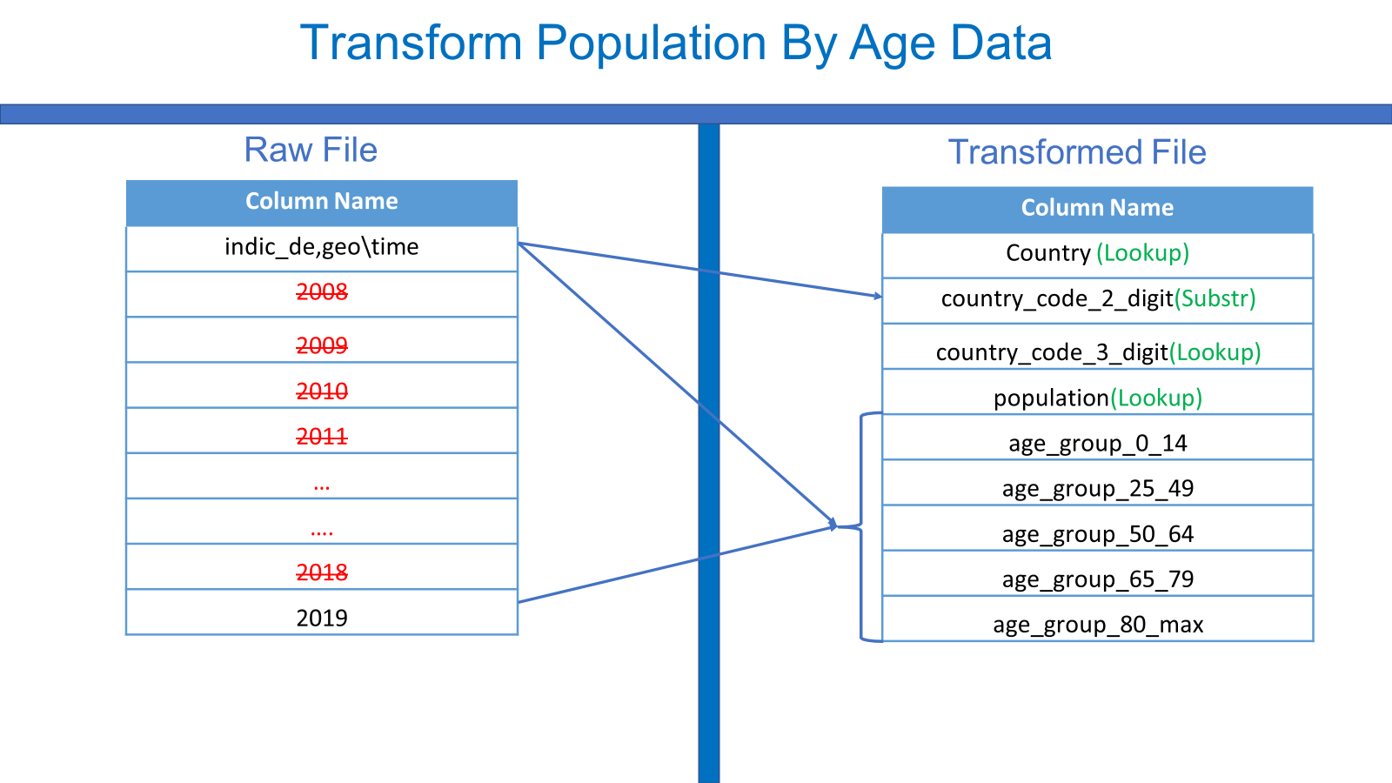

Slide 11
Thank You

